Slide 1


Agricultural Marketing - Linking farmers to market
Vivekananda Education Society’s Institute of Technology, Computer Department
Vidya Katara-D12A
Sonal Misal - D12C
Priyanka Patil-D12C
06 March 2020

Slide 2
Abstract.
The objective of our system is that the farmer can have better value for their
products as well as the consumer can have better choice for investment. Our system is aims to resolve the issues faced by farmers while selling agro products.This application removes the middle man so the farmer can directly connect with consumers and can get higher value
for their products. One of the major advantage is that it is time saving for the customers also it helps companies to buy agro products in bulk without the interference of the middle man.
06 March 2020

Slide 3
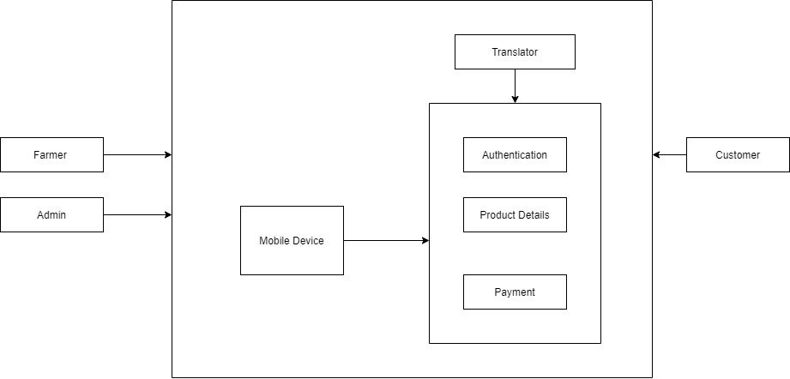
Proposed Architecture/Diagram
06 March 2020

Slide 4
Technology Stack
HARDWARE
Mobile
Computer System
SOFTWARE
Android Studio(3.5.3)
TOOLS
Android Studio
Gradle
ADB(Android Debug Bridge)
Firebase
06 March 2020

Slide 5
Conclusion
This android based application on agricultural marketing is a very effective way for farmers to sell and buyers to buy their products.
The use of this application can result in a reduction of fraud agents who try to get the products from farmers without proper intimation.

